Slide 1
ELEVATE DIGITAL GALLERY PITCH DECK
DECEMBER 2018
Draft & Confidential

Slide 2
PROBLEM
“Only 1 out of 4 people feel they are living up to their creative potential.”
- state of create global study*
Our target audience of artists and designers:
lack ability to monetize creative work
lack gallery space for exposure
desire creative and professional outlets
*State of Create Study by Adobe 2012

Slide 3
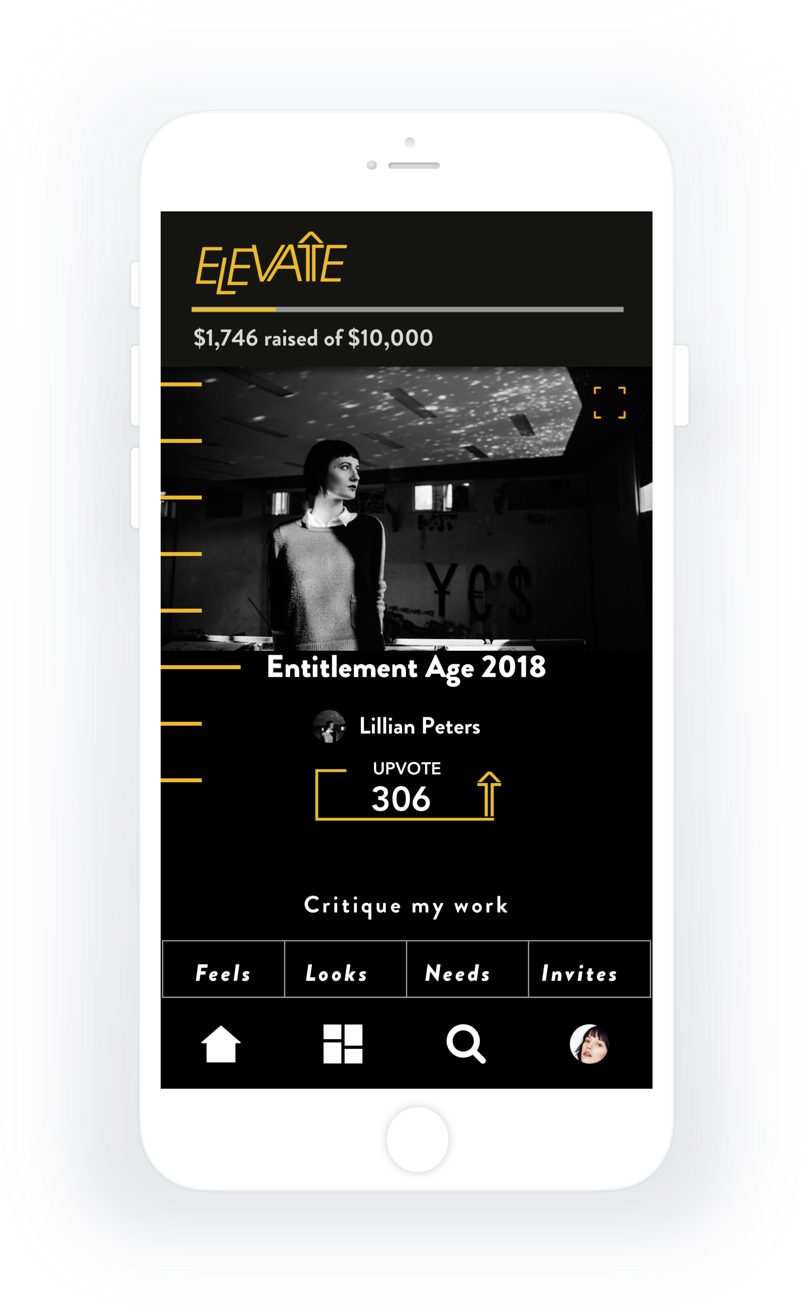
Elevate is a new concept of gallery, introducing peer-to-peer funded digital exhibits and collectives.
EleVATE
DEMOCRATIZING ART EXHIBITS

Slide 4
Creativity and vision need a place to thrive
Artists create and find value in their most innovative and exciting creative work
Artists strengthen their creative skills and stay motivated to create with the support of high caliber creative professionals and influencers
Curated exhibits are judged by industry professionals
Peer-to-peer funded exhibits allow artists gain both exposure to art buyers and financial rewards

Slide 5
GALLERY BuSINESS MODEL
USERS PAY SUBMIT WORK TO EXHIBITS
80% of FUNDS RELEASED tO
TOP SUBMISSIONS
Artist fees are $9.99 per exhibit or a monthly subscription fee of $19.99 for all access to platform
Elevate users can upvote and down vote submissions to curate exhibit
POOLED SUBMISSION FEES CREATE REWARDS
20% pRODUCT COMMiSION
Influencer judges vote for winning submission during live event
Funds are in escrow until exhibit is complete
DIGITAL & TRAVELING EXHIBIT
Digital exhibit is available online and showcased with gallery partners

Slide 6
01
02
03
04
05
CUSTOMER ACQUISiTION
Projected Results
TimeLINE:3 MONTHS
mARKETING BUDGET:$51,000
CUSTOMER ACQUISITION COST: $33
TOTAL REGISTERED USERS: 8,625
(15% of VISITORS)
TOTAL PAYING: 863
(10% of REGISTERED)
PRESS & SOCIAL STRATEGY
FRIENDS & FAMILY
INFLUENCER STRATEGY
VIRAL GROWTH
Phase 1: Friends and Family-
Phase 2: BETA TESTERS & WAIT LIST
Phase 3: Soft Launch & Testing
Phase 4: SCALABLE STRATEGY
Proprietary & Confidential | ©2016 ELEVATE GALLERY | All rights reserved.

Slide 7
COLLABORATION WITH BRANDS
Pitch creative briefs in partnership with top brands looking for selection of creative talent, artist led concepts or inspiration/research in their brand space.
Subscription fees for premium users go beyond artists to reach collectors, patrons, art enthusiasts and more:
Curate exhibit with Elevate
Find collaborators with unique matchmaking algorithm
Pitch creative briefs to Elevate community
PREMiUM MEMBERSHIP
SPONSORSHIP
Get sponsors to match crowdfunding proceeds for key exhibits and leverage creative thinking.
Connect artists and collectors to generate percentage of sales revenue.
Art SaLES

Slide 8
FUNDS DISTRIBUTED in 2017
ELLO
$71K
Elevate aims to be competitive against Kickstarter as exhibits pool submissions fees to create a peer to peer funded challenges.
Ello's sucess as a space for Artists demonstrates the needs for an art-focused platform. In 2017, they gave $71,000 to artists in comparison to Kickstarter raised $15 million for artists.
KICKSTARTER
$14 MIL
FUNDS DISTRIBUTED BY 2020*
ELEVATE GALLERY
$11.6 MIL
http://icopartners.com/2018/01/kickstarter-2017-year-review
*ProJECTIONS BASED ON SINEW BIZ MODEL GROWTH

Slide 9
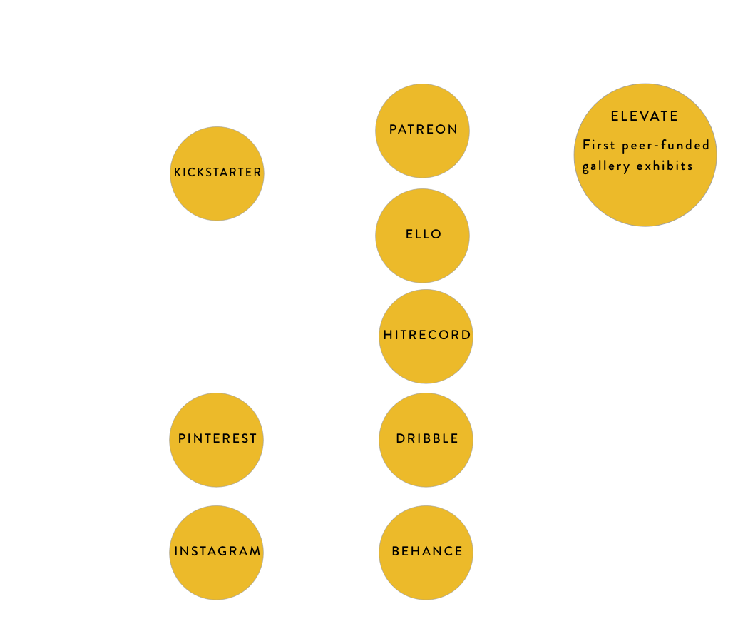
COMPETITION
ELEVATE is a modern concept of “gallery”, streamlining the experience to be relevant and leverage the success of crowdfunding in the arts.
Proprietary & Confidential | ©2018 ELEVATE GALLERY | All rights reserved.

Slide 10
MARKET SIZE
CROWDFUNDING
ART
140 MIL
$34 Bil
$45 Bil
75.3 Mil
CreatIVES
INDUSTRY
USA
75.3 Million Millennials in USA consider creativity to be a very important job and lifestyle factor. 1
Worldwide
140 Million people consider themselves to be creative. 2
ART
In 2017, art sales created $45 billion USD, in revenue globally. 3
CROWDFUNDING
In 2015, a worldwide estimate totaling over $34 billion USD, was raised by crowdfunding. 4
1.https://en.wikipedia.org/wiki/The_Cultural_Creatives
2.https://www.whitehouse.gov/sites/default/files/docs/millennials_report.pdf
https://www.forbes.com/sites/chancebarnett/2015/06/09/trends-show-crowdfunding-to-surpass-vc-in-2016/#15e5d6844547
https://news.artnet.com/market/tefaf-2017-art-market-report-880727

Slide 11
FINANCIALS
SCENARIO 1
Paying Customers 20%
SubscriptIon/month $9.99
ComMission 20%
-
YEAR 1
YEAR 2
YEAR 3
YEAR 4
Income
PLATFORM Users
20,507
362,454
1,960,330
5,051,006
Premium Users
4,101
72,490
392,066
1,010,201
(20%)
POOLED FUNDS
$280,257
$7,193,579
$49,801,942
$203,402,113
Gross Profit
$56,102
$1,438,715
$9,960,388
$40,680,422
(20%)
Expenses
Labor
$852,000
$1,052,000
$1,552,000
$2,552,000
Marketing
$70,000
$70,000
$120,000
$120,000
Office Space
$55,000
$55,000
$100,000
$100,000
IT
$30,000
$33,000
$35,000
$37,000
Legal
$25,000
$25,000
$30,000
$30,000
Net Profit
-$975,898
$203,715
$8,168,388
$37,886,422

Slide 12
FINANCIALS
SCENARIO 2
Paying Customers 10%
SubscriptIon per month $19.99
ComMission 20%
YEAR 1
YEAR 2
YEAR 3
YEAR 4
Income
PLATFORM Users
20,507
362,454
1,960,330
5,051,006
Premium Users
2,100
36,245
196,033
505,100
(10%)
POOLED FUNDS
$140,257
$3,596,789
$24,900,971
$101,701,056
Gross Profit
$28,051
$719,357
$4,980,194
$20,340,211
(20%)
Expenses
Labor
$852,000
$1,052,000
$1,552,000
$2,552,000
Marketing
$70,000
$70,000
$120,000
$120,000
Office Space
$55,000
$55,000
$100,000
$100,000
IT
$30,000
$33,000
$35,000
$37,000
Legal
$25,000
$25,000
$30,000
$30,000
Net Profit
-$1,003,949
-$515,643
$3,188,194
$17,546,211

Slide 13
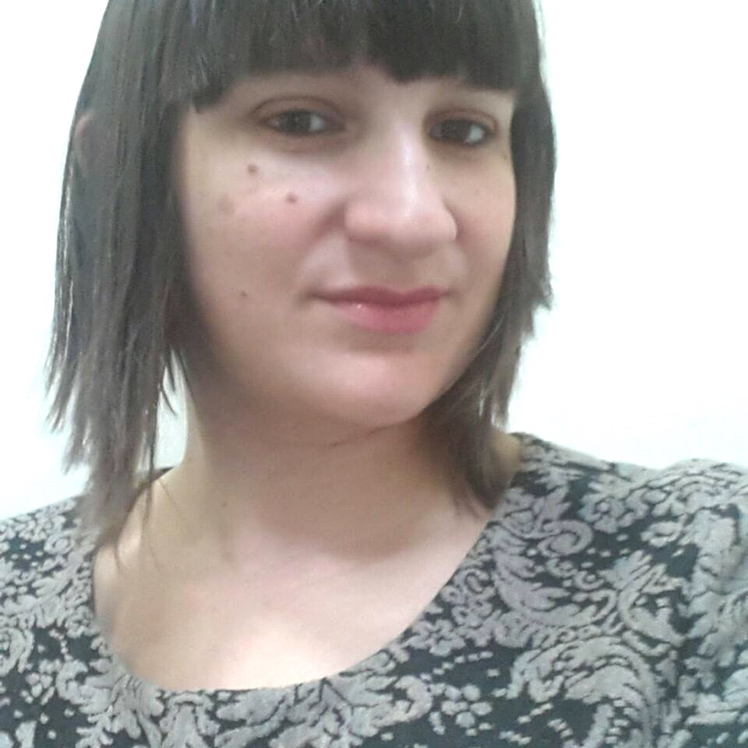
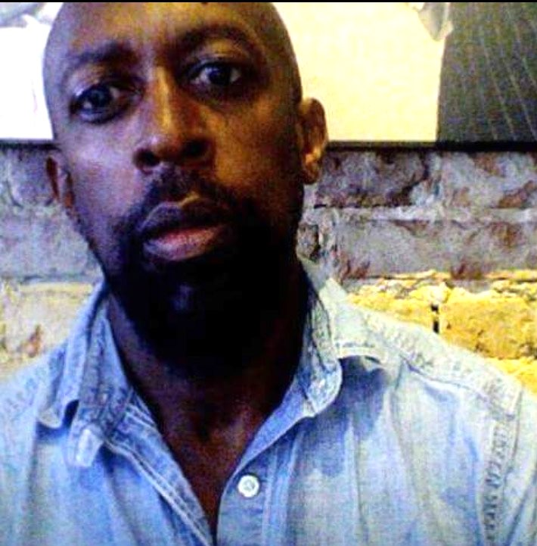
BRIELLE MAXWELL
MalCOM BECKFORD
Brielle Maxwell has been called the modern day Gertude Stein by legendary New York artists. Brielle is a Senior Experience designer with Mercedes-Benz and design entrepreneur with a mind for how art and design can create a new breed of businesses. Through an interdisciplinary approach, she hopes to expand the dialogue of arts in culture.
Born in Birmingham England, Malcolm began his career as a Fashion Editor/Stylist for The Face, I.D. Arena, & Vogue Homme International.
He moved behind the camera in 2002, to capture celebrities to street art with his unique perspective.
He resides in Brooklyn NY.

